Slide 1
Angular Demos ng new, ng serve, (ng-)bootstrap library basic elements: button, menu, tab, ..
arnaud.nauwynck@gmail.com
Course Esilv 2024
This document: https://github.com/Arnaud-Nauwynck/presentations/web/ angular-demos-1-ng-new-ngbootstrap.pdf

Slide 2
2 pre-requisites: 1/ install node.js 2/ $ npm install -g @angular/cli
Also recommended :
3/ have 1G disk free on your PC
4/ install Intellij or Visual Studio Code
5/ network bandwidth
6/ patience

Slide 3
$ ng new
Create a new application

Slide 4
Upgrade existing @angular/cli .. If needed
$ ng update @angular/cli or
$ npm uninstall @angular/cli
$ npm install –g @angular/cli

Slide 5
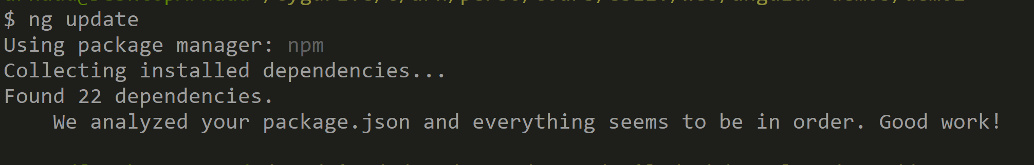
Upgrade existing angular project … if needed $ ng update

Slide 6
« ng new » alternatives
1/ $ git clone https://github.com/${org}/${repo}
2/ jhispter
3/ read docs, edit package.json + angular.json … NOT recommended

Slide 7
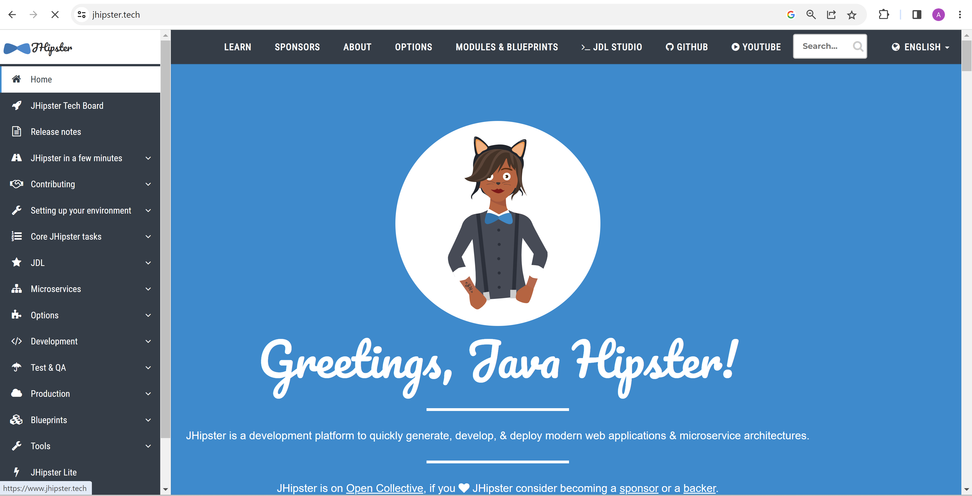
Jhipster = Java springboot(backend) + angular(frontend) app generator

Slide 8
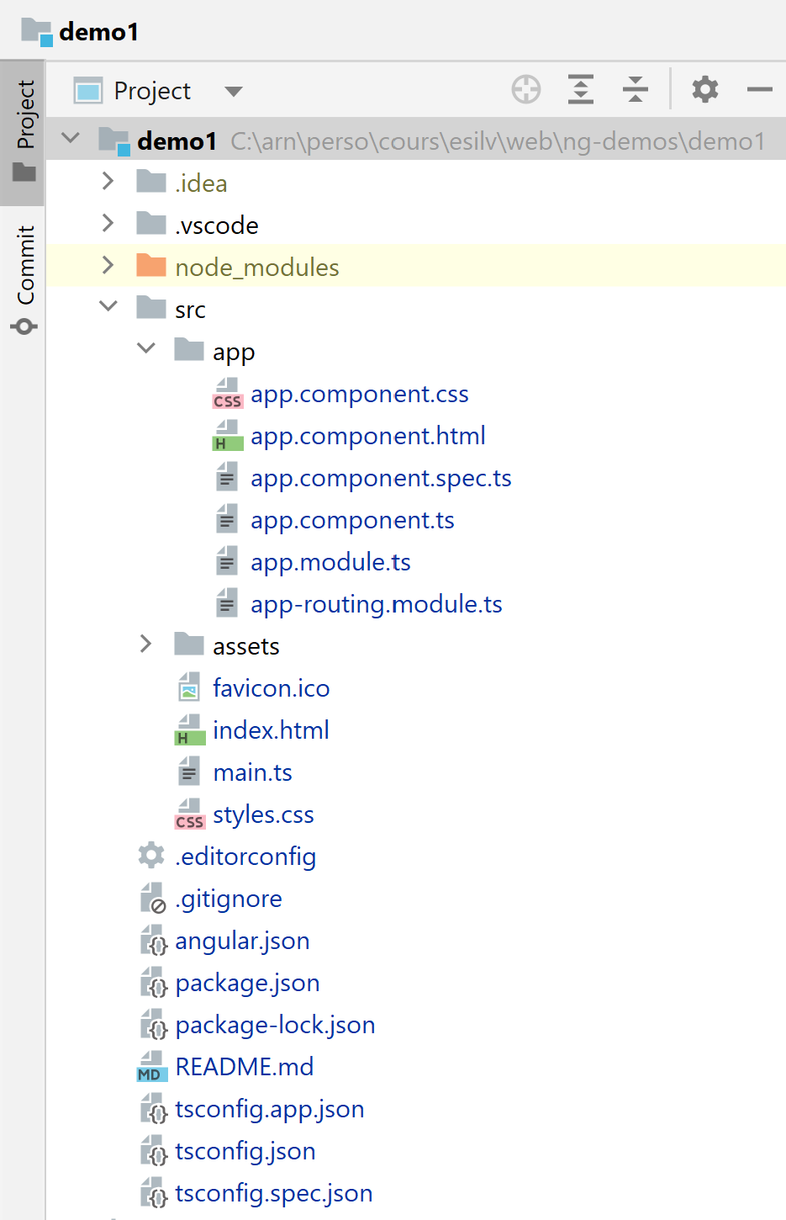
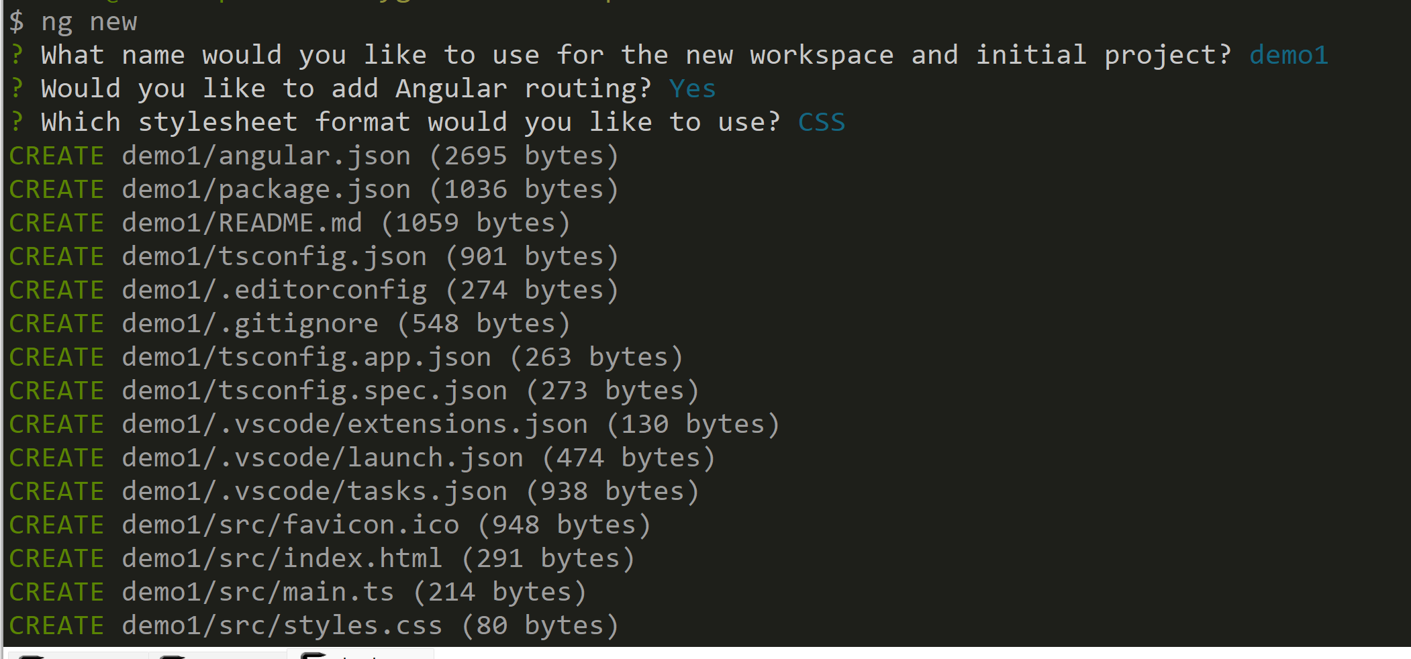
ng new

Slide 9
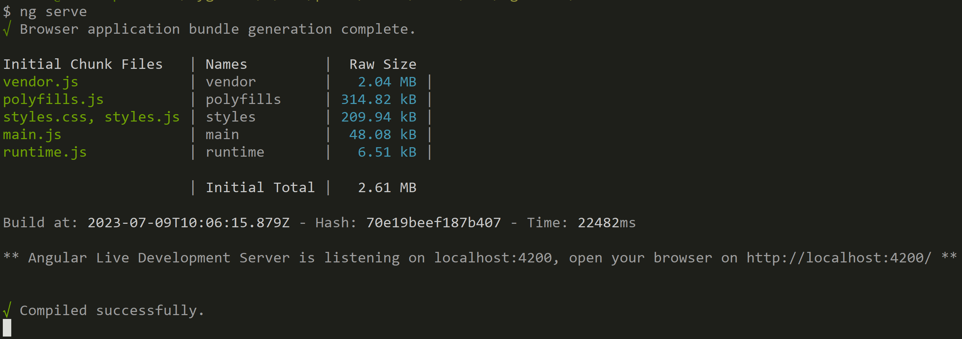
$ ng serve => http://localhost:4200

Slide 10
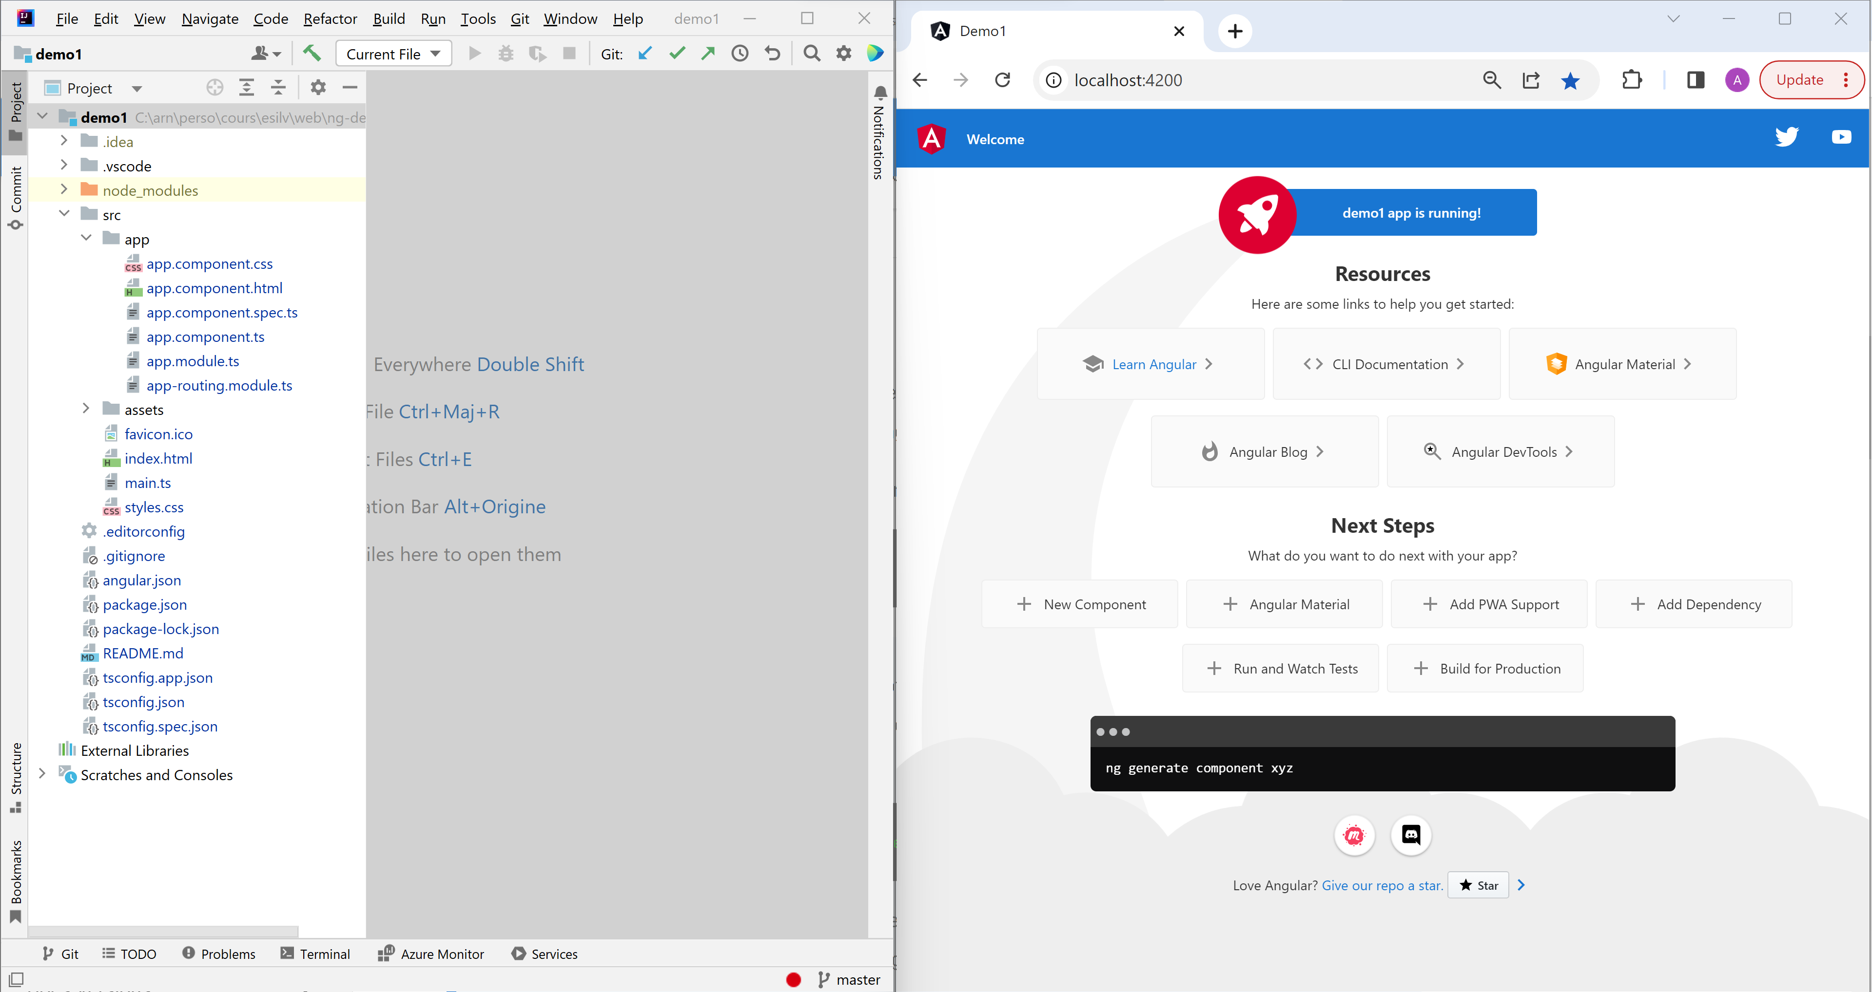
Demo IntelliJ (left) + Chrome (right) + ng serve

Slide 11
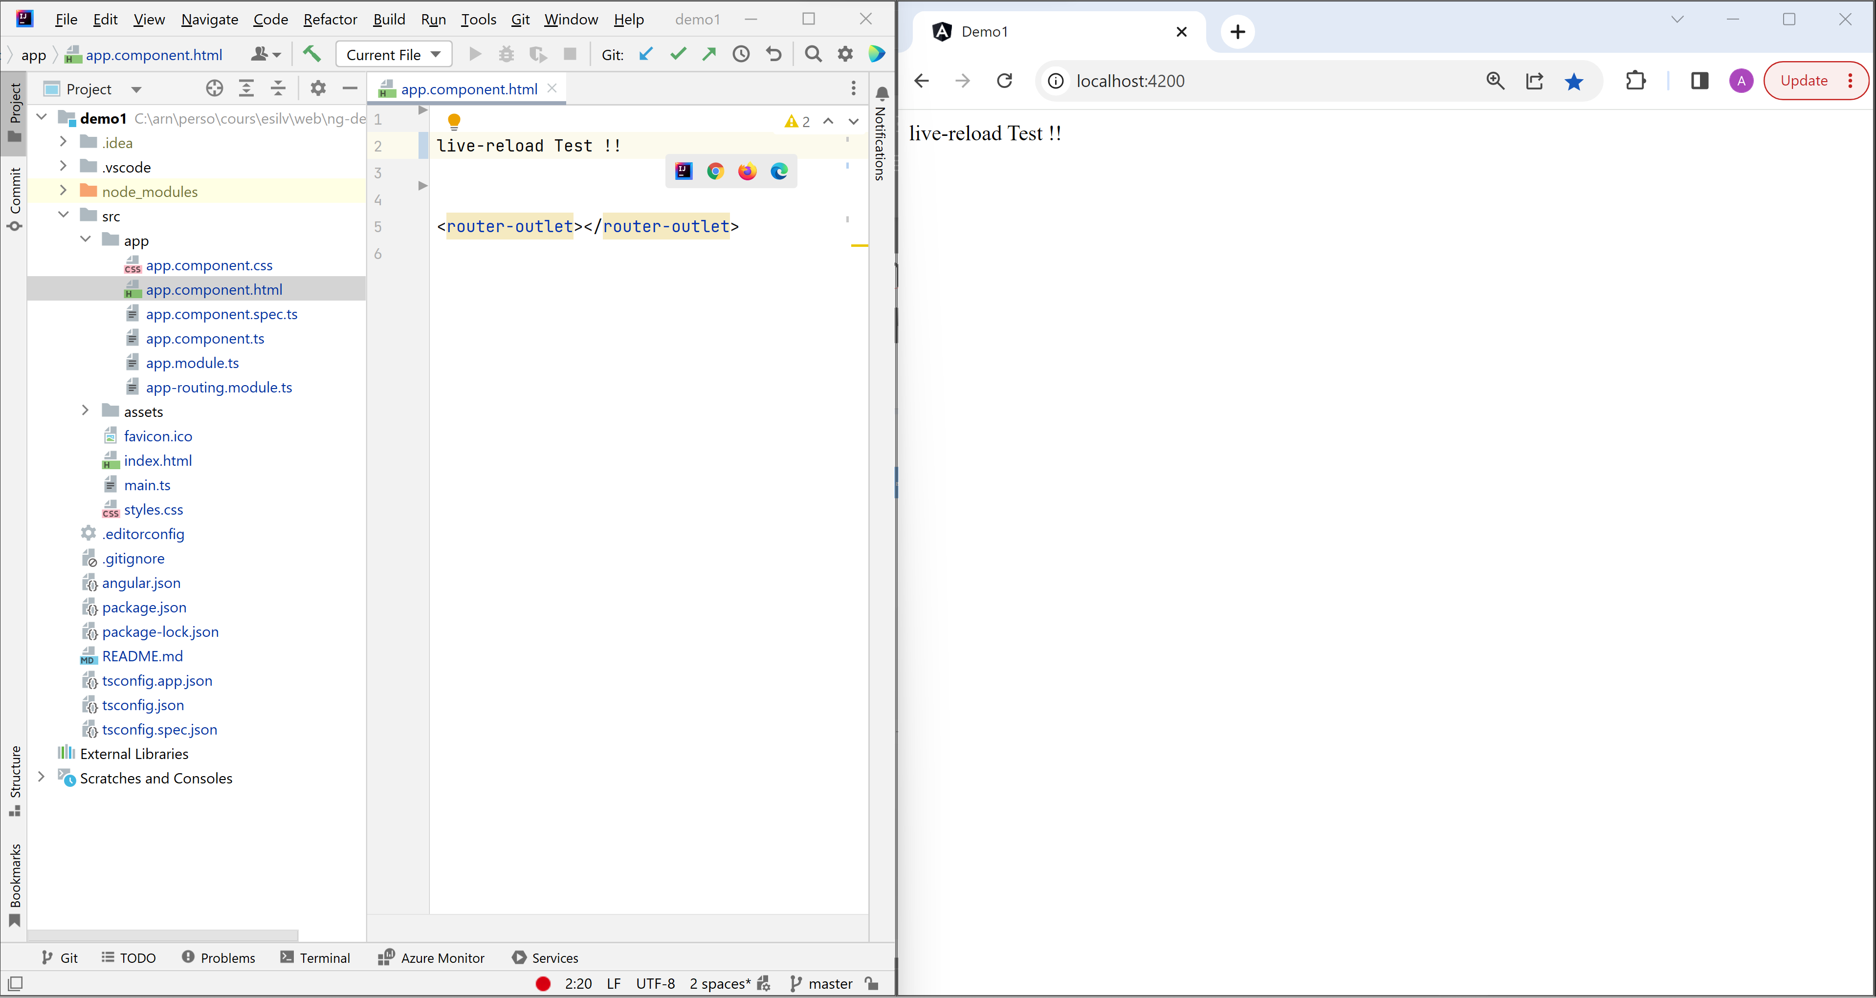
Demo … Live reload

Slide 12
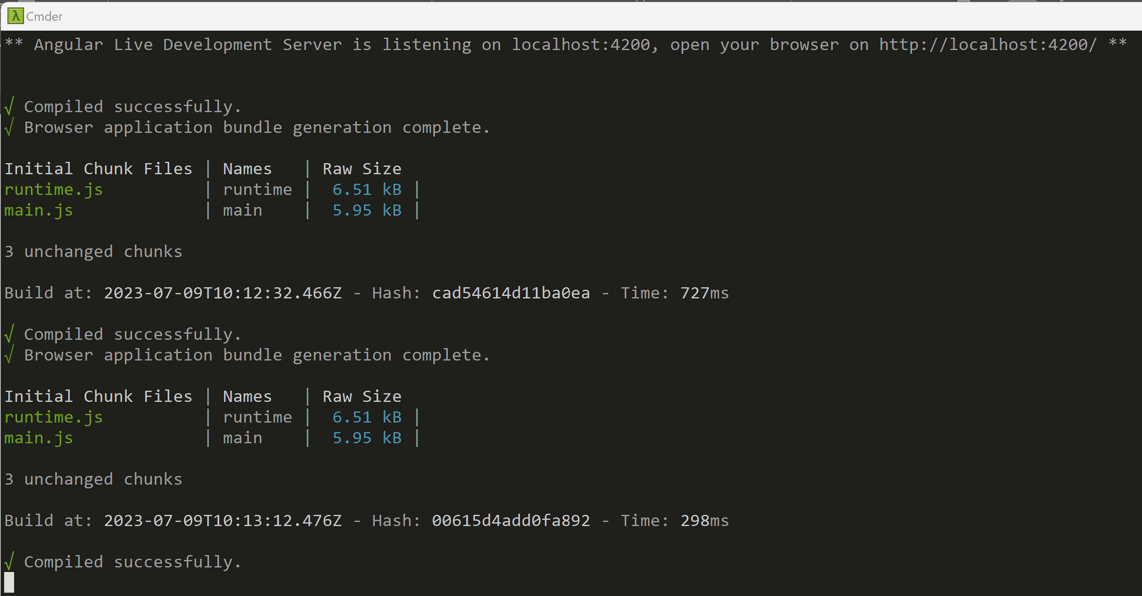
Live Reload … --watch (expect 5 seconds delay) watch File changes => compile => refresh page

Slide 13
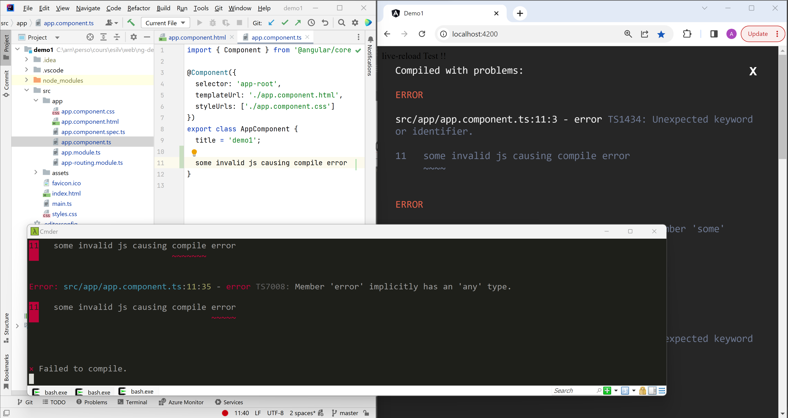
Demo live-reload … when compile error

Slide 14
Adding Bootstrap library

Slide 15
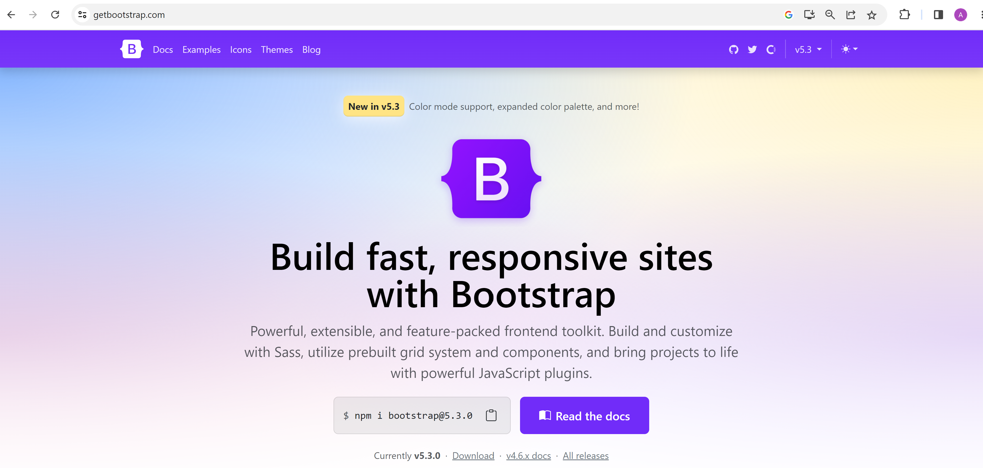
https://getbootstrap.com/

Slide 16
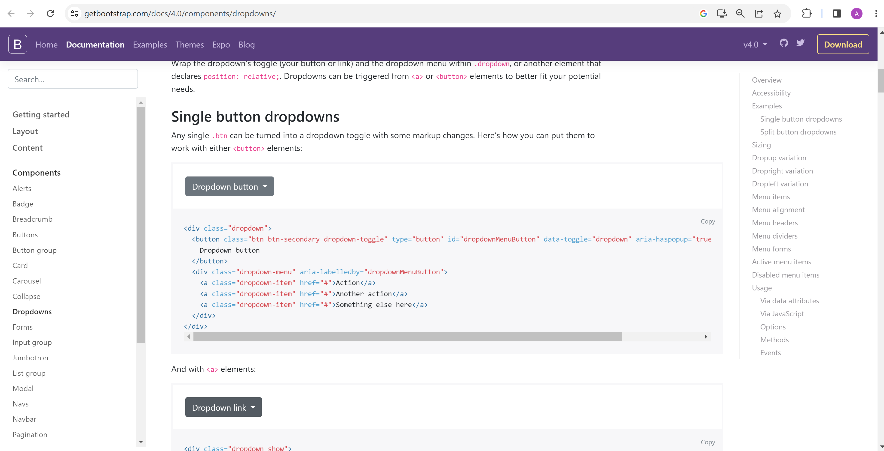
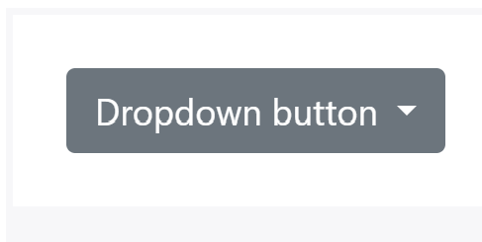
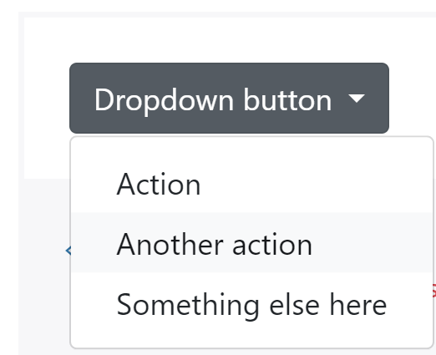
Bootstrap … example: button dropdown
click

Slide 17
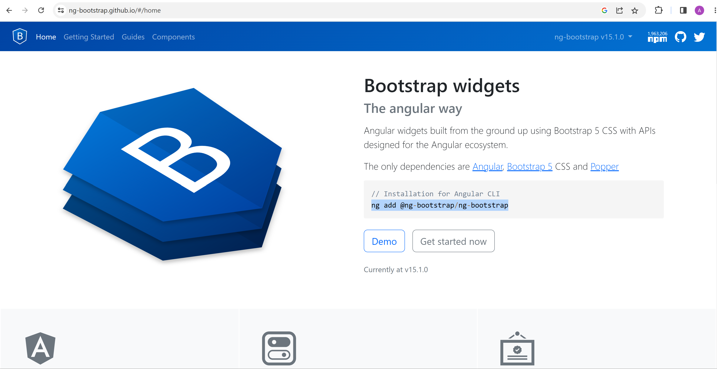
Adding via ng-bootstrap … NPM module for Bootstrap in Angular

Slide 18
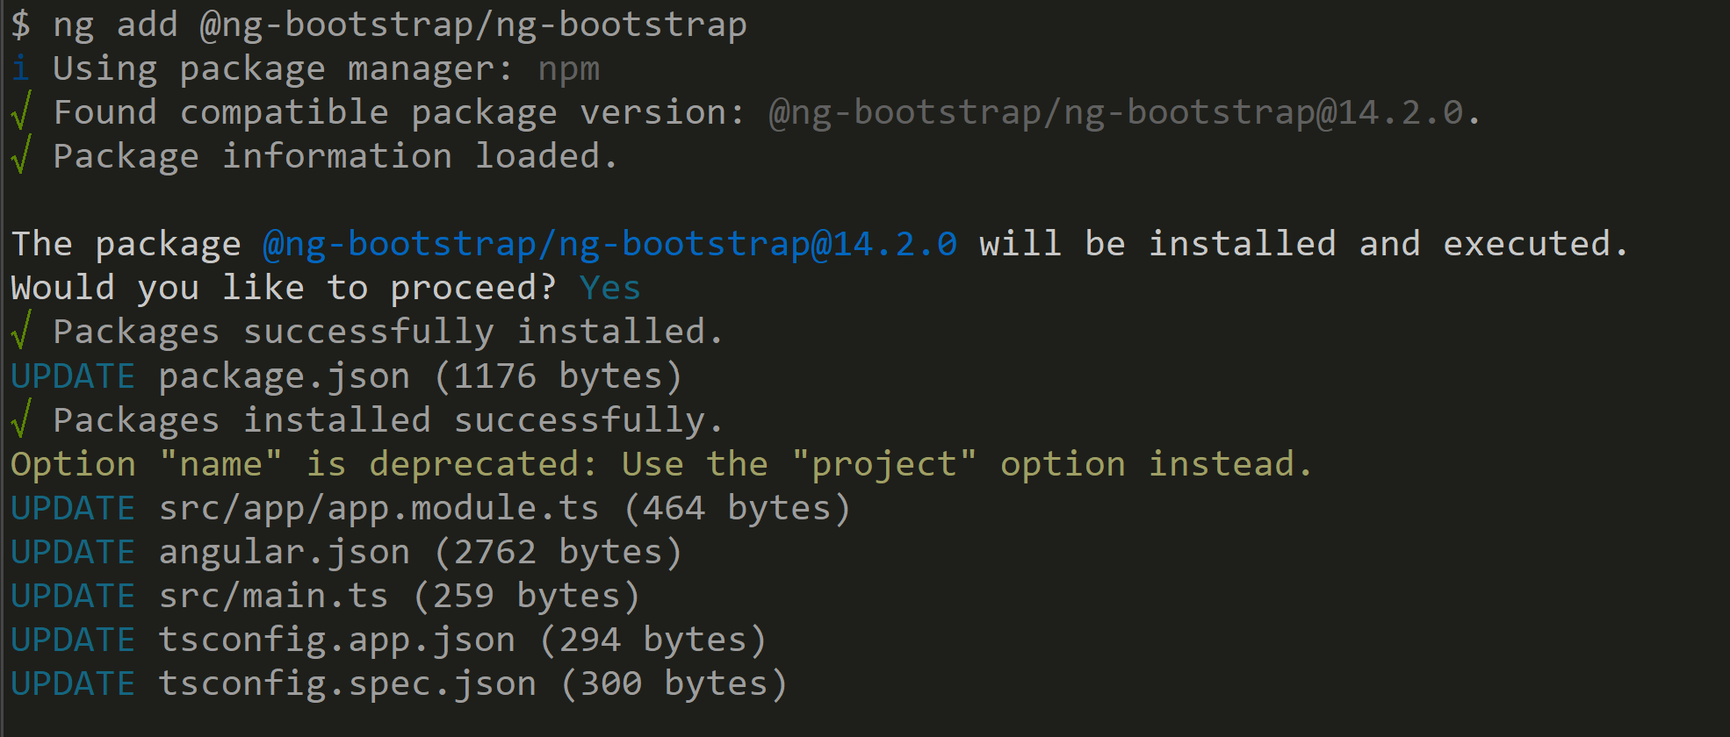
ng add @ng-bootstrap/ng-bootstrap

Slide 19
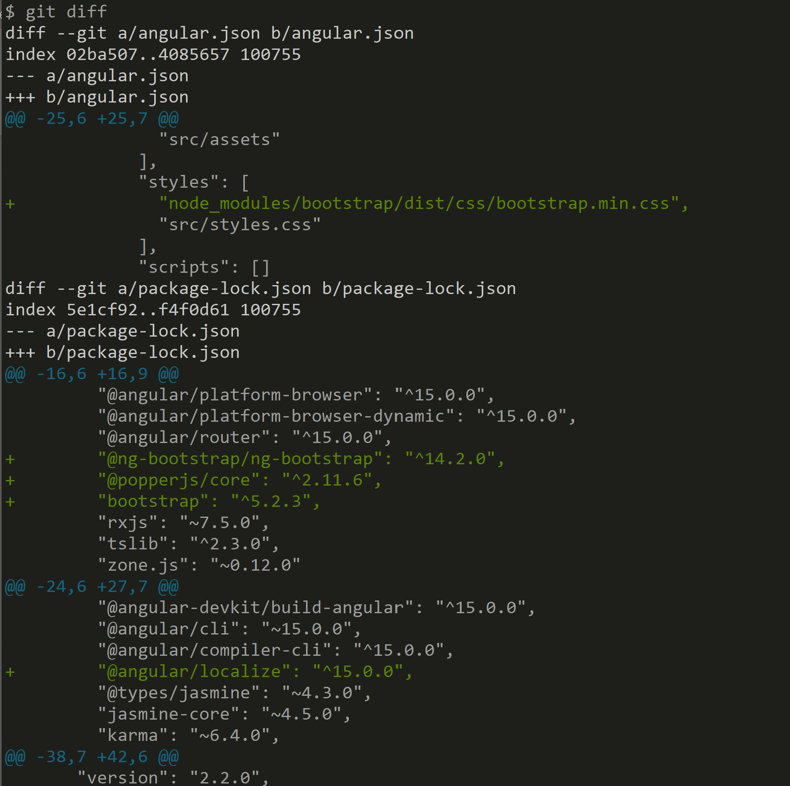
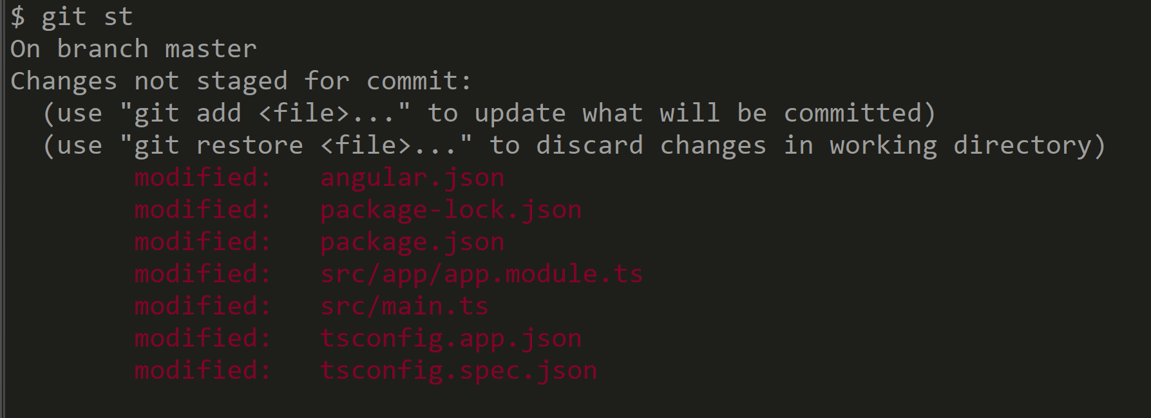
git status ; git diff

Slide 20
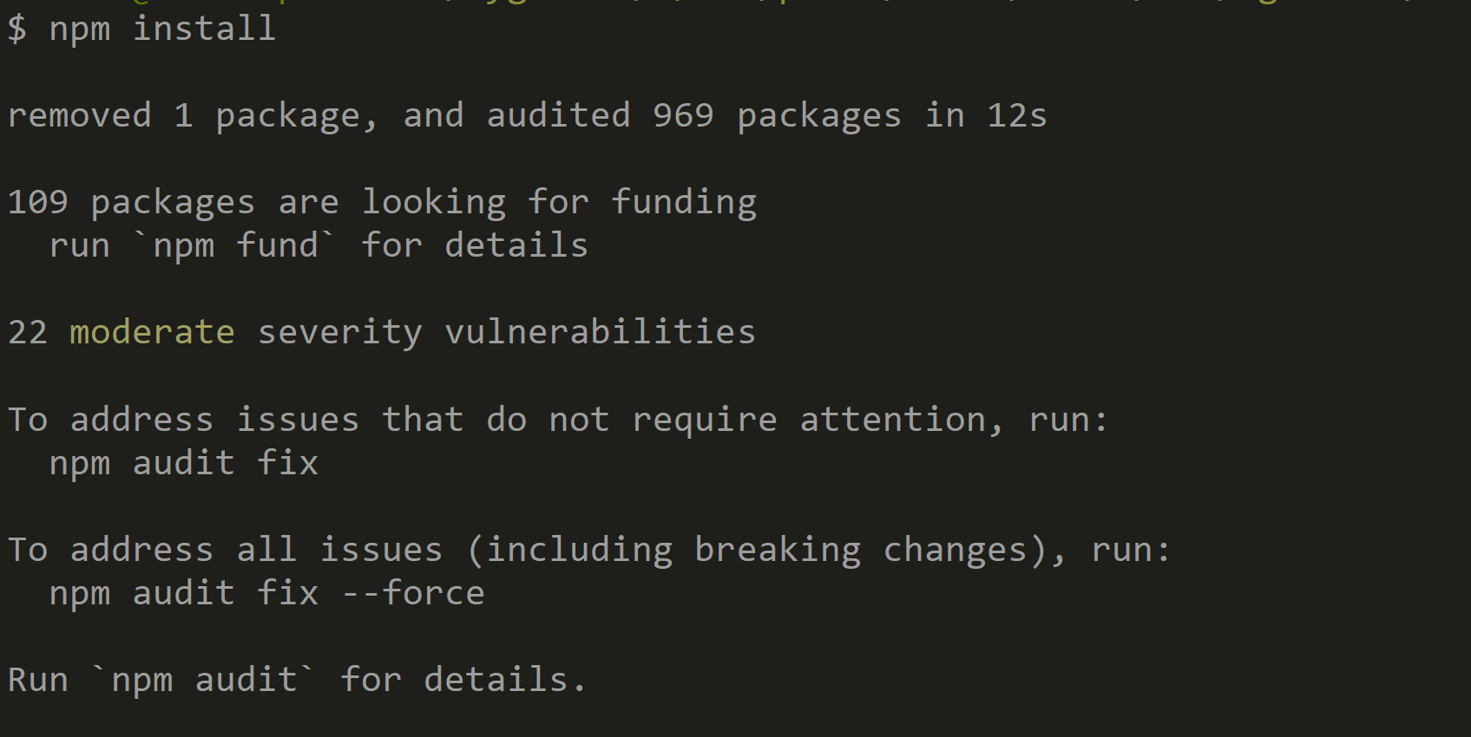
REDO npm install + stop & restart ng server

Slide 21
Bootstrap Demos

Slide 22
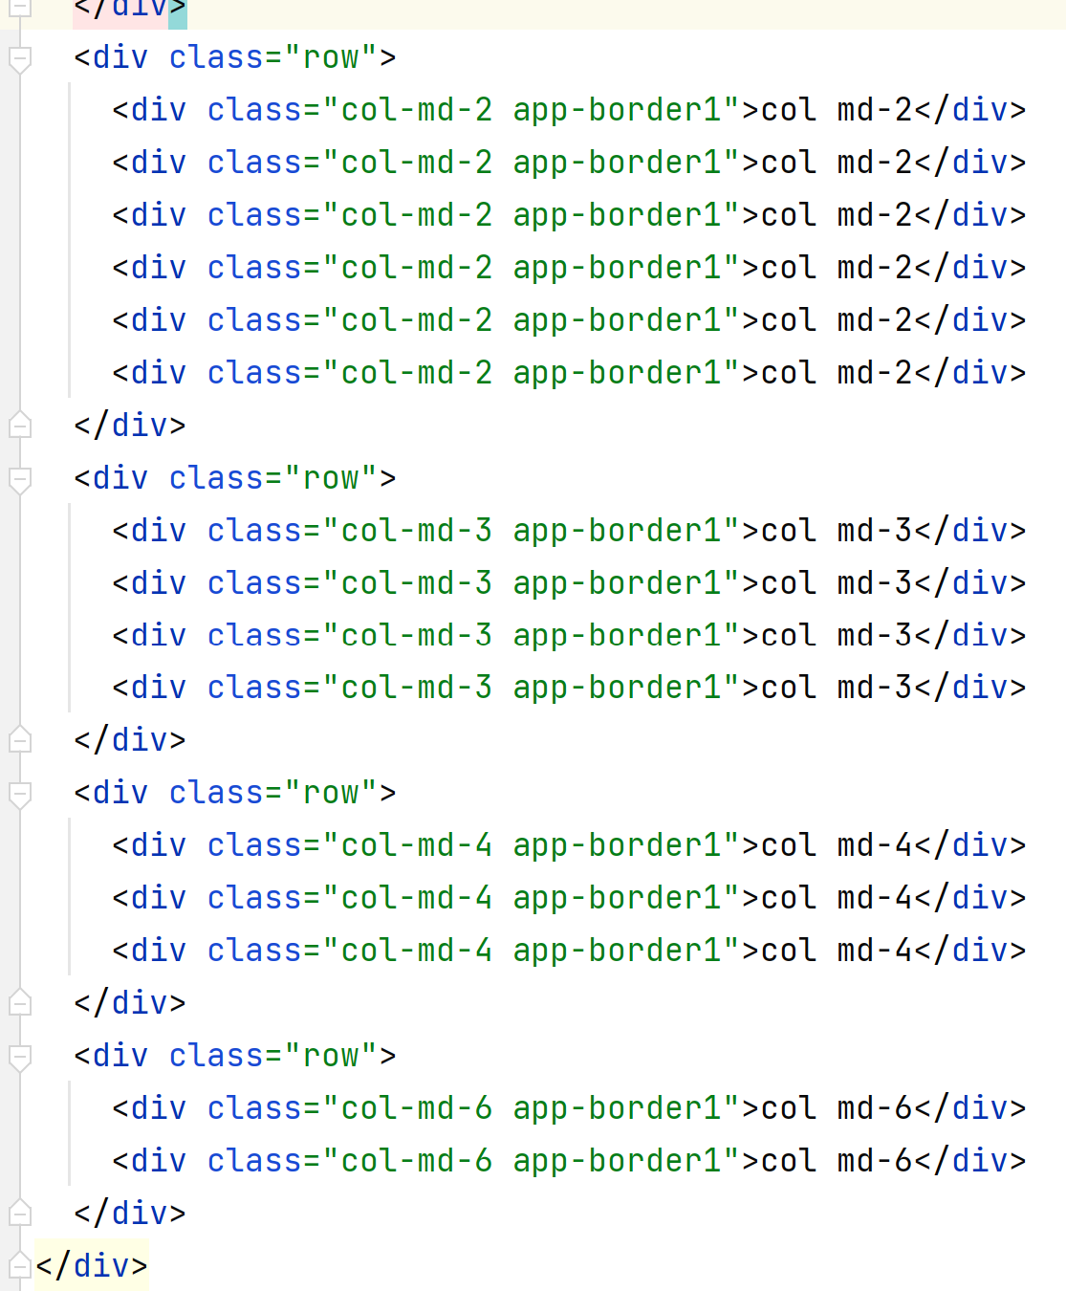
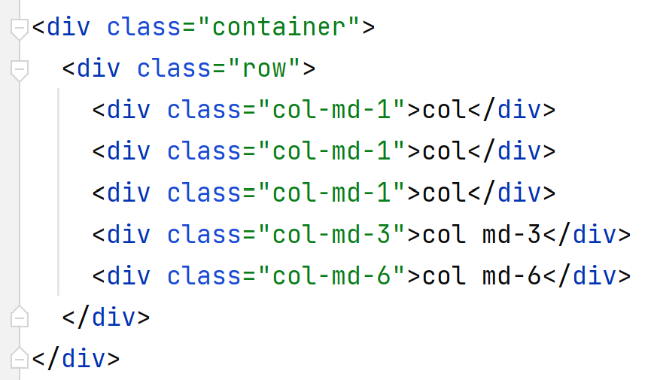
Bootstrap demo 1: Container, 12 x columns system

Slide 23
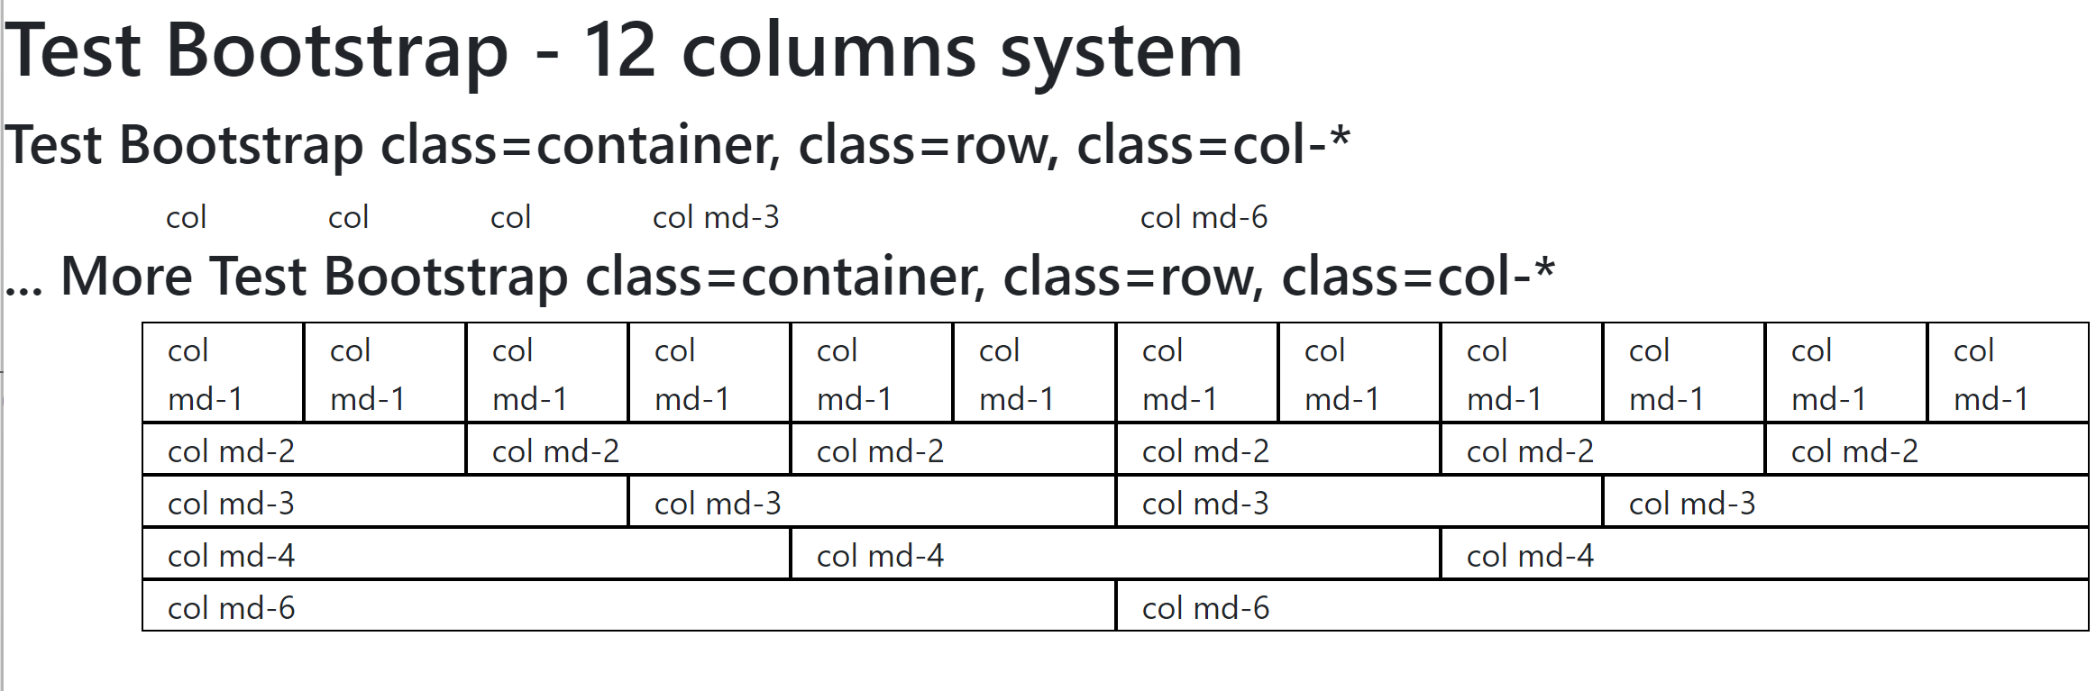
Bootstrap demo 1: Container, 12 x columns system

Slide 24
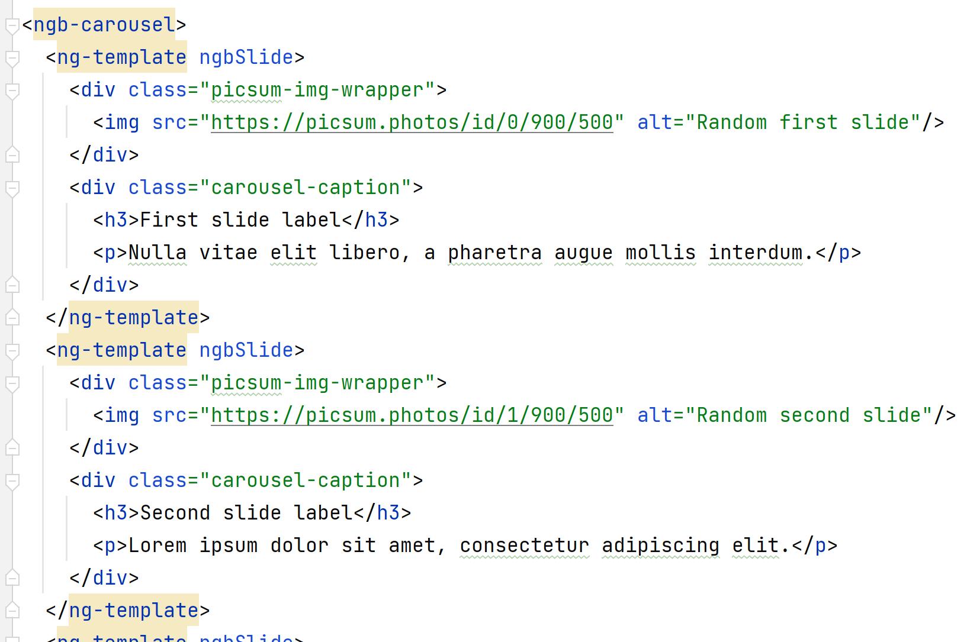
Demo Bootstrap Carousel

Slide 25
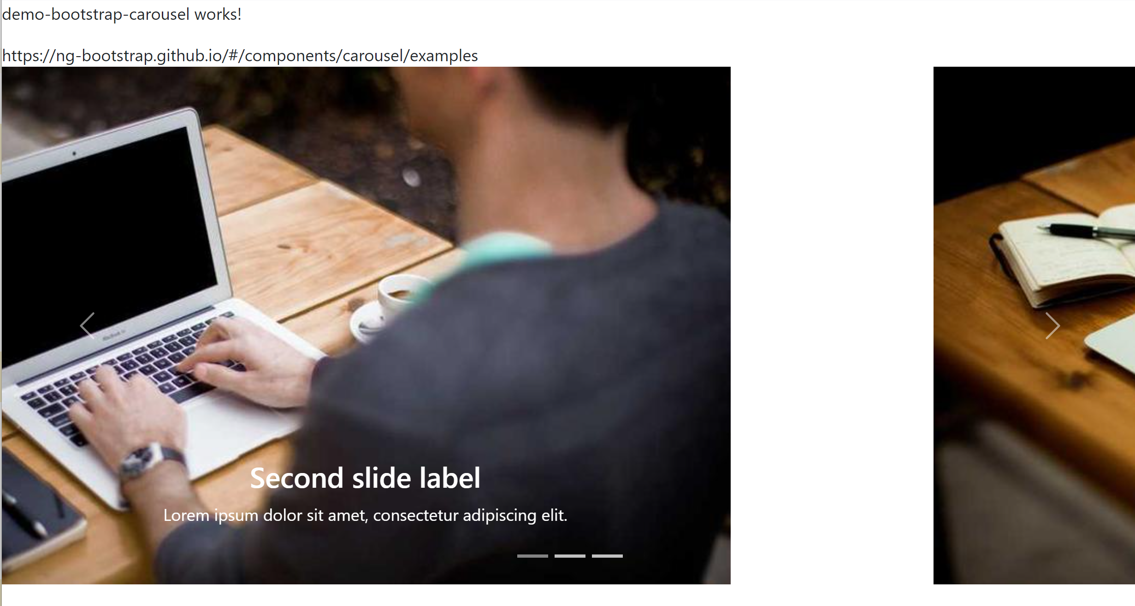
Bootstrap demo: Carousel

Slide 26
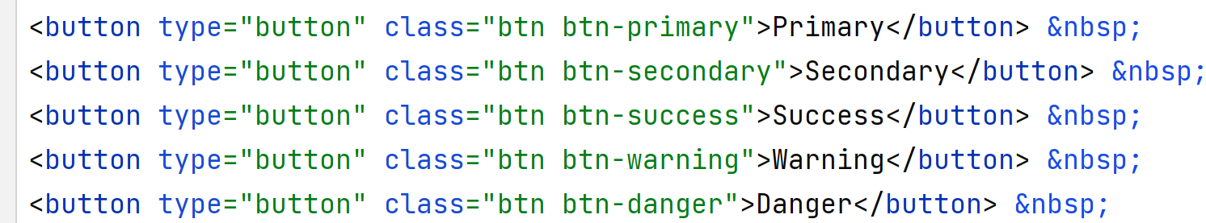
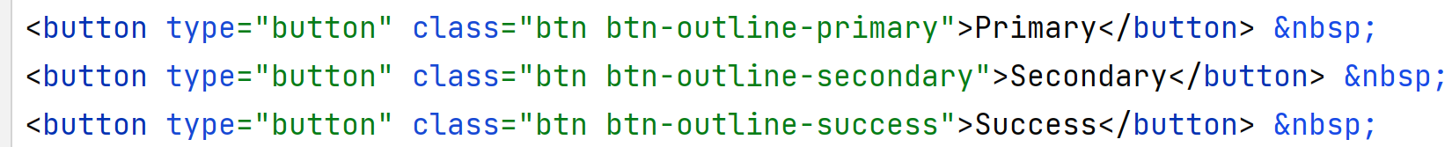
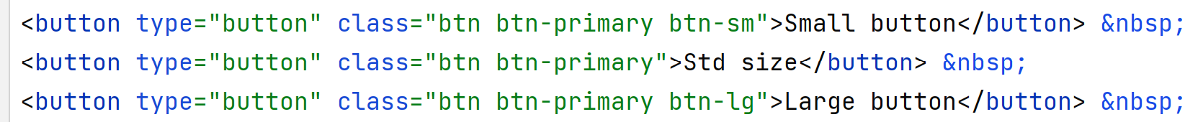
Bootstrap Button

Slide 27
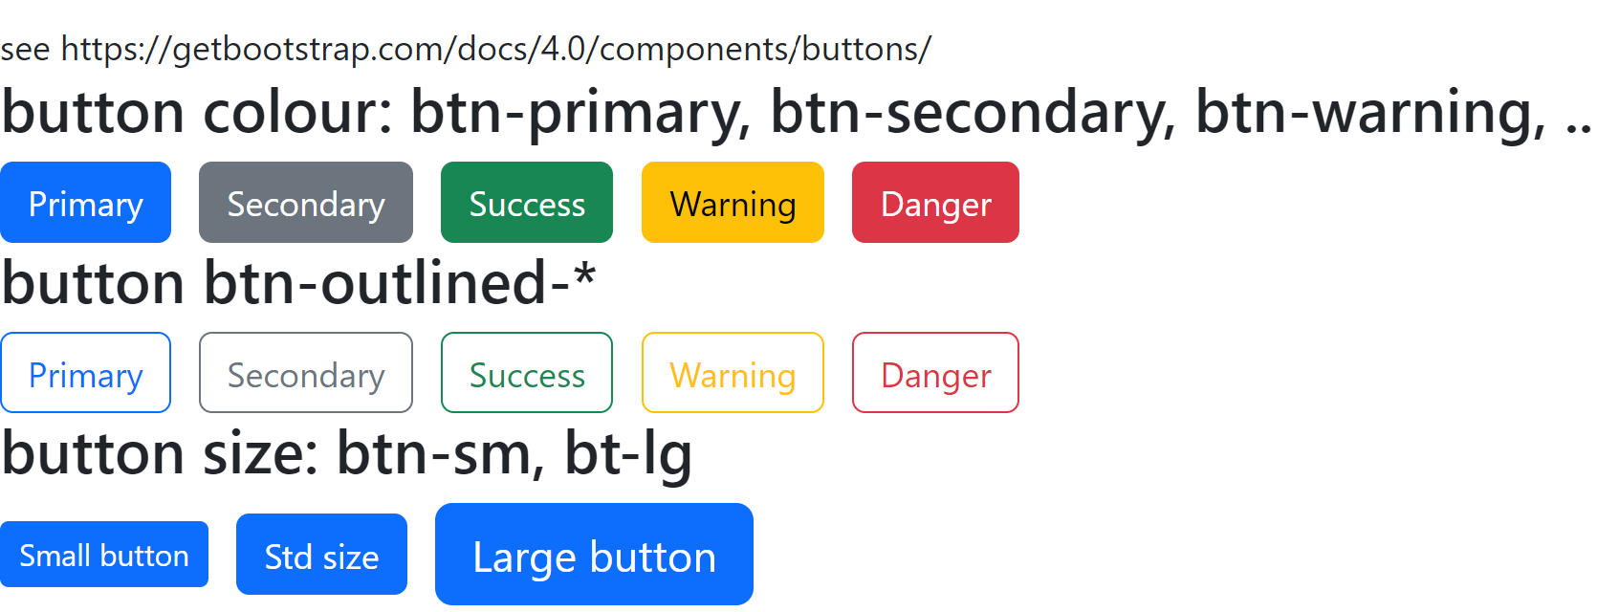
Bootstrap demo: Button styles

Slide 28
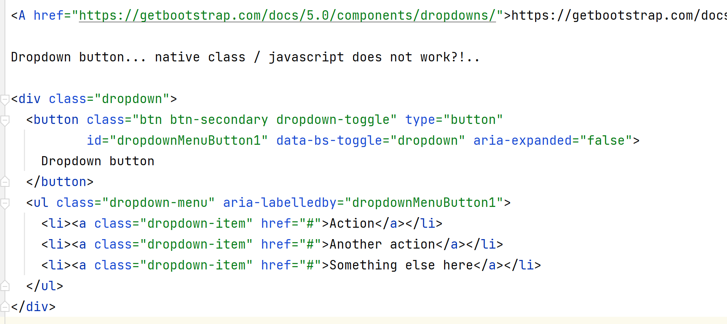
Bootstrap demo: Button dropdown

Slide 29
Bootstrap demo: Button dropdown
dropdown
does not work?!

Slide 30
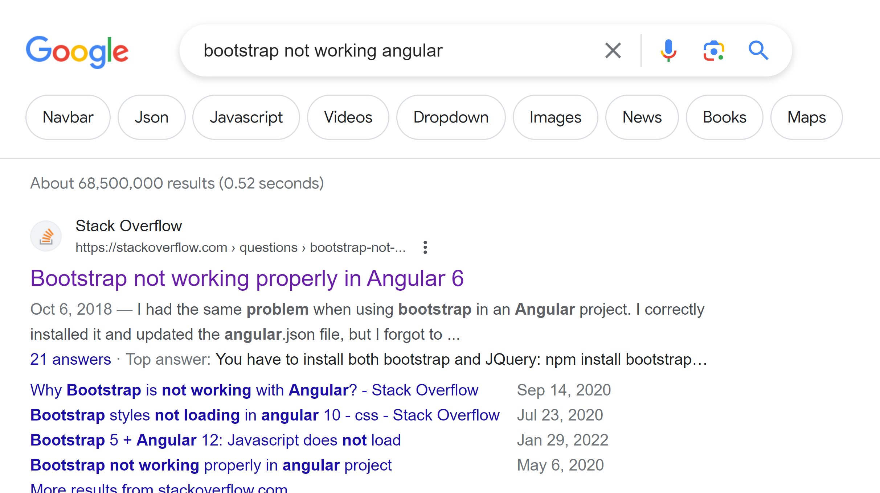
!!! Demo may not work ?? You are not alone
68 Millions bugs / pages written by developpers complaining on same

Slide 31
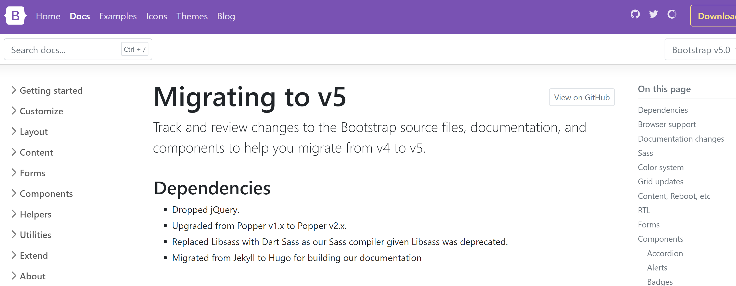
Root cause of all problems: CSS depends on JS
Finally !!
But still require Popper JS

Slide 32
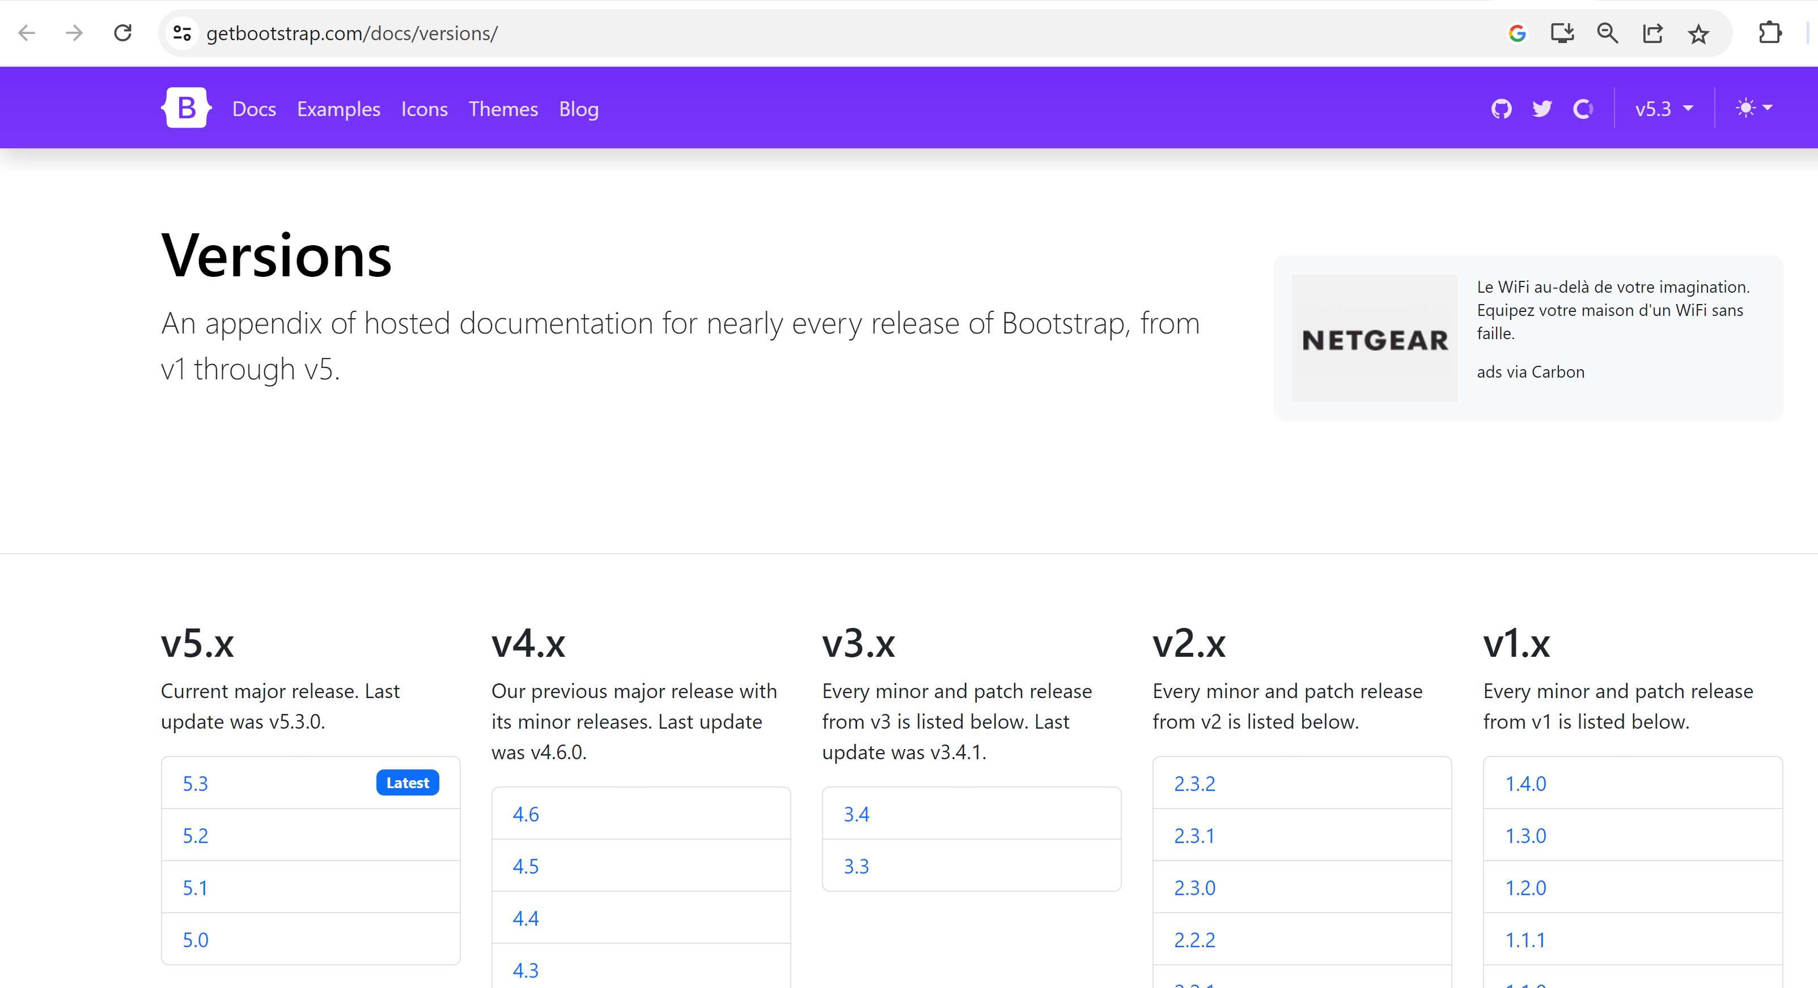
Bootstrap major versions

Slide 33
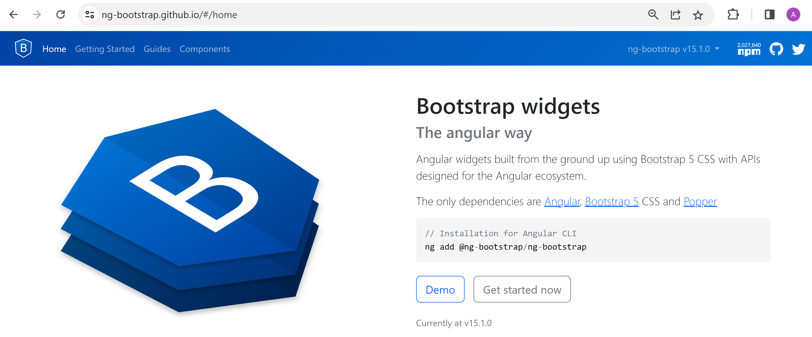
Testing basic bootstrap with dynamic javascript features => using via « ng-bootsrap »
Replace by ..
Some « Vanilla » Bootstrap
Classes + « data-toggle »=.. attributes
simpler ng-bootstrap equivalent
ngbDropDown
ngbToggle
ngb..
Ngb = initials for angular Bootstrap

Slide 34
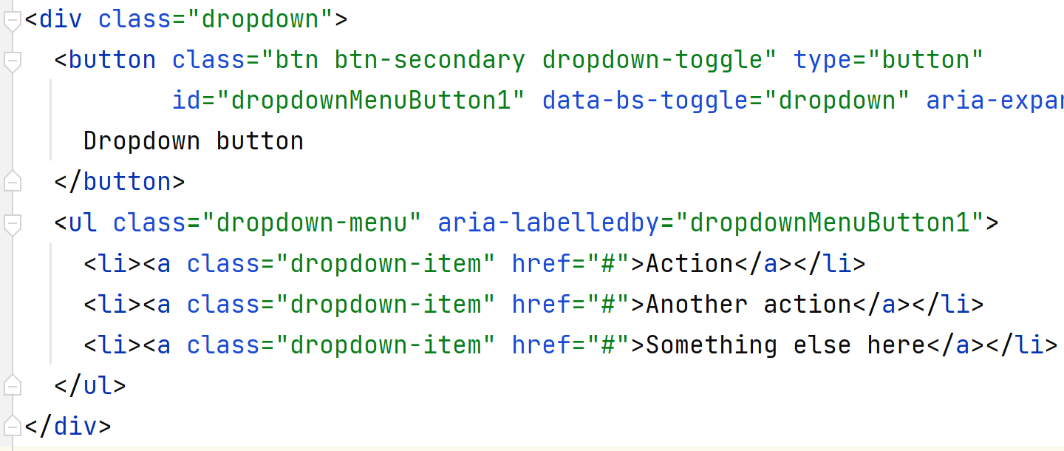
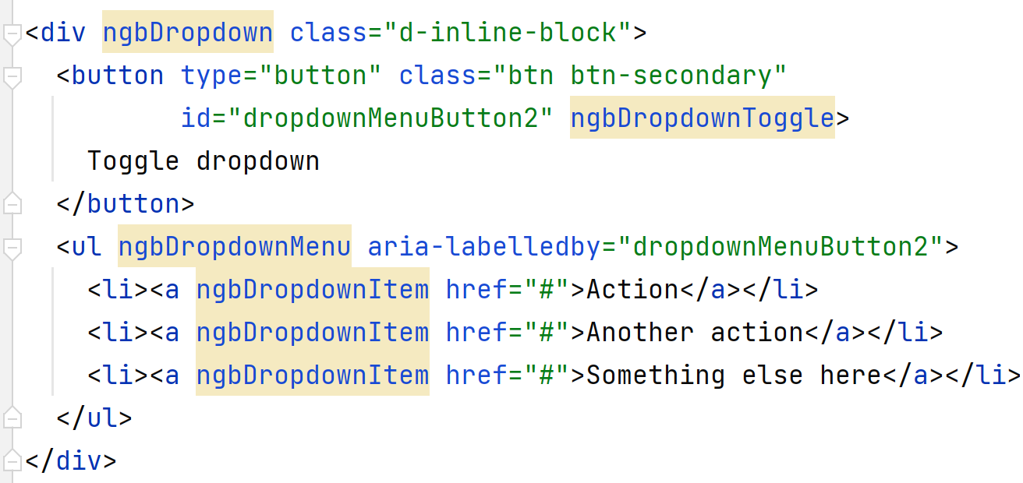
Bootstrap demo: Button dropdown

Slide 35
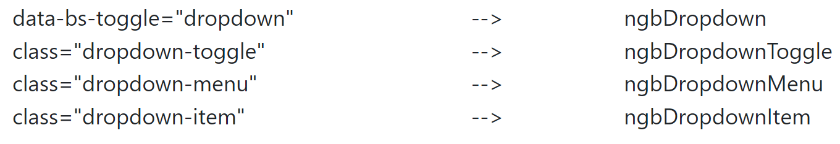
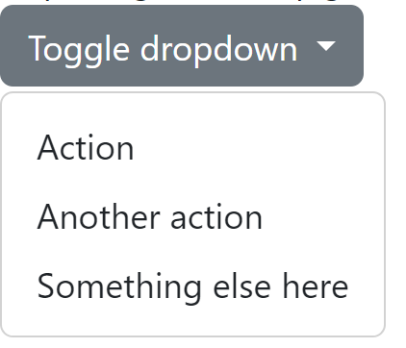
Bootstrap demo: Button ngbDropdown

Slide 36
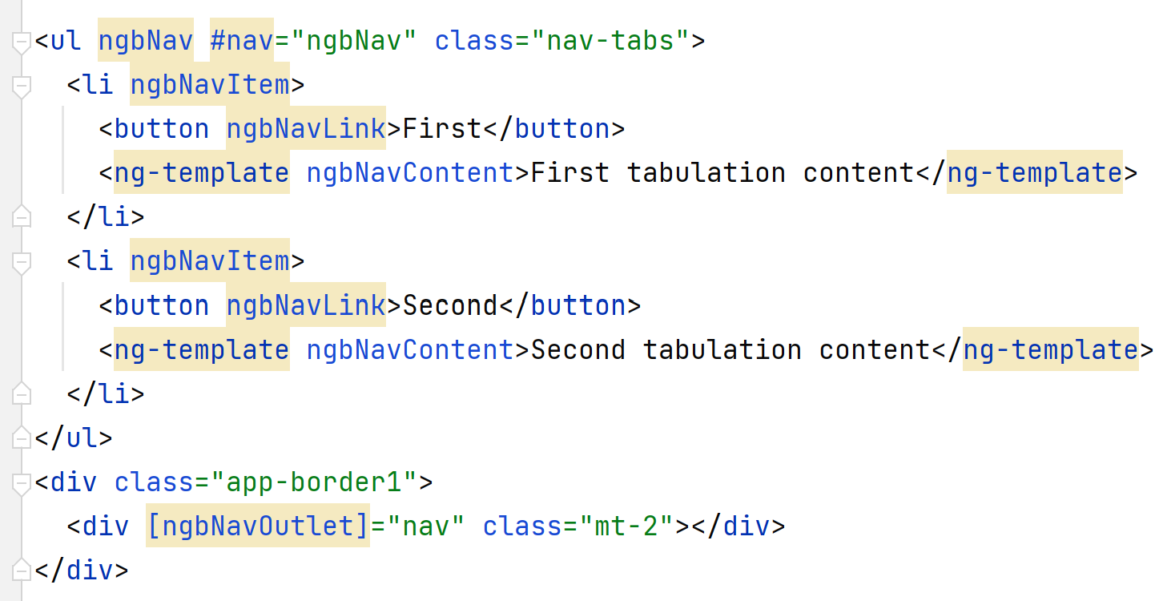
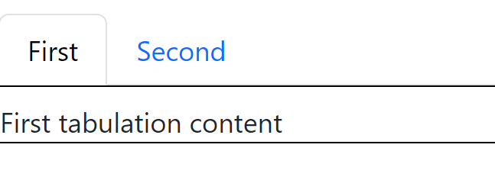
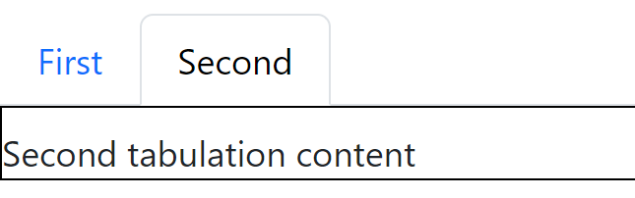
Bootstrap demo: Nav Tabulations

Slide 37
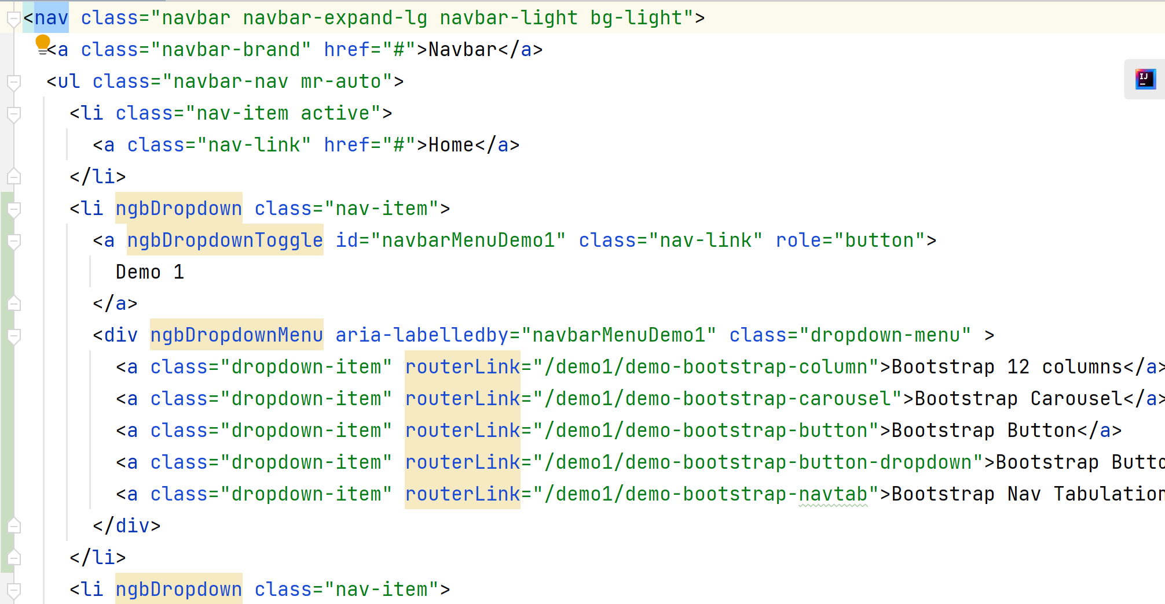
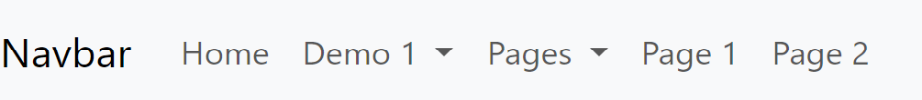
Bootstrap demo: Navbar Menu

Slide 38
Summary
Install node.js (npm)
$ npm Install –g @angular/cli $ ng new => file: package.json, angular.json app.component.{html | ts} $ ng serve $ ng add @ng-bootstrap/ng-boostrap
$ npm install
<div class=« container »> <div class=« row »> <div class=« col-mb-2 »>
<button type=« button » class=« btn btn-primary »>
<nav>

Slide 39
Take Away
$ ng new + ng serve + ng generate + …
=> GET easily a complete Angular environment … pre-packaging angular + npm + typescript + …
Add (ng-)bootstrap
=> GET basic CSS + elements … 12-columns layout system
+ button, menu nav bar, tab, etc.

Slide 40
Questions

Slide 41
Next Step
{{interpolation}}
*ngFor
*ngIf
@Component
[] .. @Input (=One way binding)
() .. @Output
[()] .. 2-Ways binding
Router
next document: https://github.com/Arnaud-Nauwynck/presentations/web/angular-demos-2-ngFor-ngIf-component.pdf

